Slide 1
Inheritance and polymorphism
Continuous staff improvement project
ION GANDRABURA

Slide 2
Introduction
Interface and abstract class.
Interface segregation Principle.
Understanding polymorphism. Forms of polymorphism.
Liskov Substitution principle.
Open closeD Principle.

Slide 3
Abstract Class
Unlike classes, these cannot be instantiated.
Like classes, they introduce types.
but no objects can have as actual type the type of an abstract class.
Why use them?
Because there is a set of common features and implementation for all derived classes but we want to prevent users from handling objects that are too generic
We do not want users to be able to create Car, Cat, etc.

Slide 4
Abstract Class
Often, the superclass does not have a "meaning" or does not directly relate to a "thing" in the real world
It is an artifact of the generalization process.
Abstract class should have an abstract member: an abstract property or abstract method, something which each subclass has but it does not necessarily exist the group as a whole.

Slide 5
Abstract Methods
An abstract method is one to which a signature has been provided, but no implementation for that method is given.
An Abstract method is a placeholder. It means that a method must exist, but there is no meaningful implementation for that method within this class.
Any class which contains an abstract method MUST also be abstract.
Abstract classes can contain both concrete and abstract methods

Slide 6
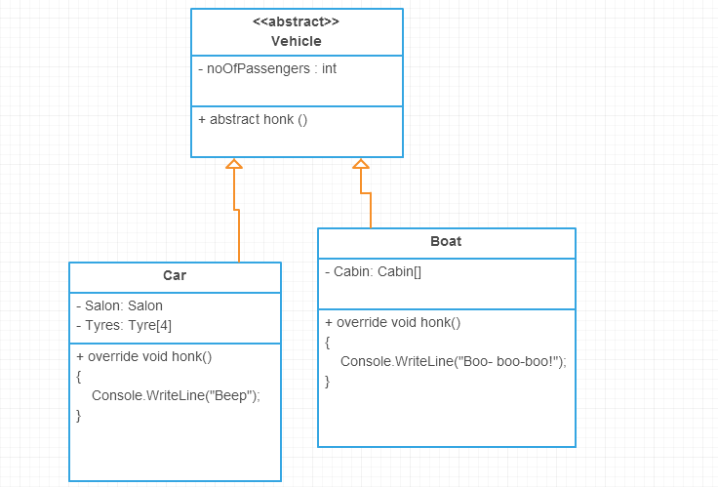
Abstract Class. Example

Slide 7
Interface
An interface is similar to an abstract class with the following exceptions
All methods defined in an interface are abstract. Interfaces can contain no implementation
Interfaces cannot contain instance variables.

Slide 8
Interface
So, what are interfaces good for if they don't implement functionality?
They define the behavior of its implementors.
They separate the specification from the actual implementation. That means that other classes will depend on something which can do IDoVeryUsefulFunction
Usually, an interface has one responsibility.
E.g. ICloneable interface in .NET has one method Clone(), the only responsibility. The other classes will depend on something which can clone without depending on implementation details.

Slide 9
Abstract Classes vs Interfaces
Can have data fields
Methods may have an implementation
Classes and abstract classes extend abstract classes.
Class cannot extend multiple abstract classes
Can only have method signatures
Methods have no implementation
Classes and abstract classes inherit interfaces
Interfaces can extend multiple interfaces
A class can implement multiple interfaces

Slide 10
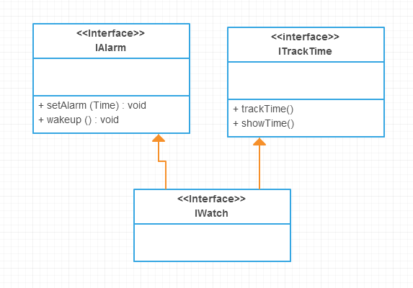
Interface. example

Slide 11
Interface Segregation Principle (ISP).
This principle deals with the disadvantages of “fat” interfaces.
The interfaces of the class can be broken up into groups of member functions depending on the use case. If class depends on several interface methods, it is better it does not depend on an interface with tens of interface methods.
The principle - CLIENTS SHOULD NOT BE FORCED TO DEPEND UPON INTERFACES THAT THEY DO NOT USE.

Slide 12
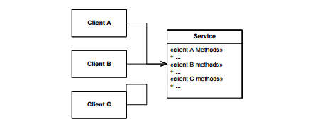
Interface Segregation Principle (ISP).

Slide 13
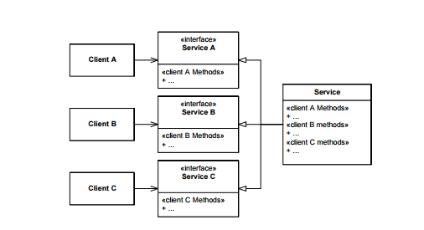
Interface Segregation Principle (ISP).

Slide 14
Polymorphism
Polymorphism means many (poly) shapes (morph)
If a function denotes different and potentially heterogeneous implementations depending on a limited range of individually specified types and combinations, it is called ad hoc polymorphism.
If the code is written without mention of any specific type and thus can be used transparently with any number of new types, it is called parametric polymorphism.
Subtyping (or inclusion polymorphism) is a concept where in a name may denote instances of many different classes as long as they are related by some common superclass.

Slide 15
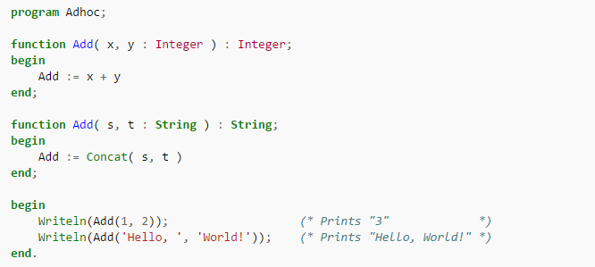
Ad hoc polymorphism

Slide 16

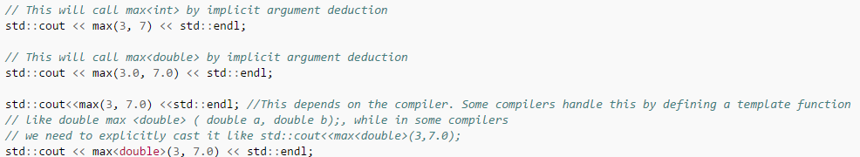
Parametric polymorphism

Slide 17
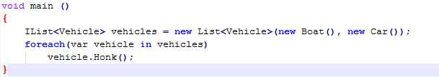
inclusion polymorphism

Slide 18
inclusion polymorphism
In the previous example a vehicle variable has the compilation type of Vehicle.
The runtime type can be any subtype of Vehicle – a boat or a car and we cannot know its type compile time.
If you think of modern games, each unit can for example Shoot() and Run(). Usually, this logic is written only once but gets many forms depending on the unit type.

Slide 19
The Liskov Substitution Principle
FUNCTIONS THAT USE POINTERS OR REFERENCES TO BASE CLASSES MUST BE ABLE TO USE OBJECTS OF DERIVED CLASSES WITHOUT KNOWING IT.
Child class should not break parent class’s type definition and behaviour.

Slide 20
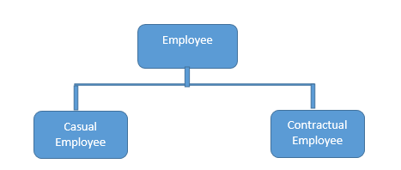
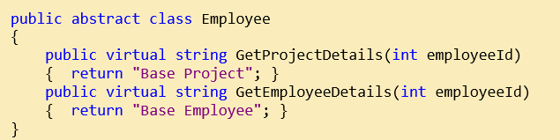
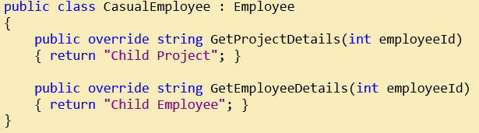
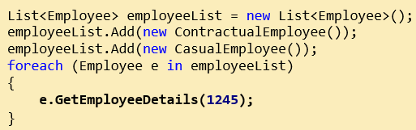
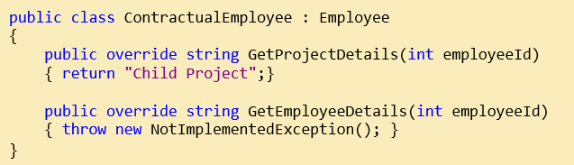
The Liskov Substitution Principle
For contractual employee, you will get not implemented exception and that is violating LSP

Slide 21
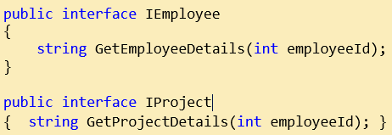
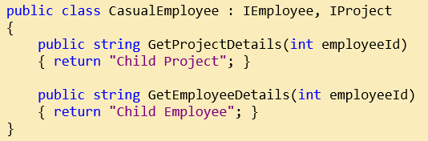
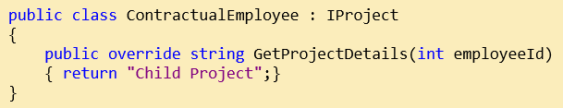
The Liskov Substitution Principle
Solution is to break in 2 different interfaces - IProject and IEmployee and implement according to Employee type
contractual employee will implement IEmployee
not IProject

Slide 22
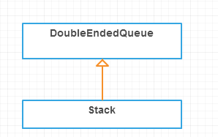
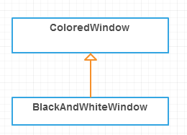
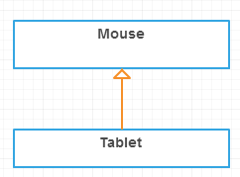
Do not Inherit Then
Limitation - The child class limits some of the behavior of the parent class
Variation - The child class is simply a variation of the parent class

Slide 23
The Open Close Principle
SOFTWARE ENTITIES (CLASSES, MODULES, FUNCTIONS, ETC.) SHOULD BE OPEN FOR EXTENSION, BUT CLOSED FOR MODIFICATION.
When a single change to a program results in a cascade of changes to dependent modules, that program exhibits the undesirable attributes that we have come to associate with “bad” design.
The program becomes fragile, rigid, unpredictable and unreusable.
We should write our modules so that they can be extended, without requiring them to be modified.

Slide 24
The Open Close Principle
They are “Open For Extension”. This means that the behavior of the module can be extended. That we can make the module behave in new and different ways as the requirements of the application change, or to meet the needs of new applications.
They are “Closed for Modification”. The source code of such a module is inviolate. No one is allowed to make source code changes to it.
Even if the OCP cannot be fully achieved, even partial OCP compliance can make dramatic improvements in the structure of an application. It is always better if changes do not propagate into existing code that already works. If you don’t have to change working code, you aren’t likely to break it.

Slide 25
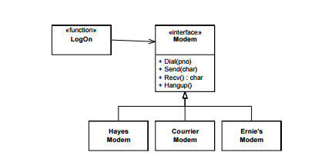
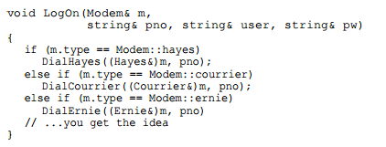

The Open Close Principle

Slide 26
Assignment
Read UP on abstract class and Interface
Understand ISP, OCP and Liskov Principles
Understand all the forms of polymorphism
for each principle create an example which violates the principle and one that solve the problem.

